Slide 1
Supervised Machine Learning
Georgina Dangerfield

Slide 2
What is machine learning?
Giving computers the ability to learn to make decisions based on data
Examples
Predicting whether an email is spam
Clustering wikipedia entries into different classes
Unsupervised learning - used unlabelled data
Supervised learning - used labelled data
Reinforcement learning - optimising given a system of rewards and punishments

Slide 3
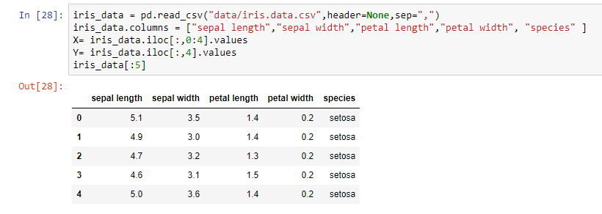
Supervised Learning
Predictor variables/features and a target variable
Aim: Predict the target variable, given the predictor variables
Classification: Target variable consists of categories or classes
Regression: target variable is continuous

Slide 4
Instructions: Drag and drop the machine learning examples into the correct box.
Classification | Regression
Is an email spam or not spam?
How much will my food cost in 10 years?
Will it be hot or cold tomorrow?
Predicting someone’s gender based on their handwriting
What will the temperature be tomorrow?

Slide 5
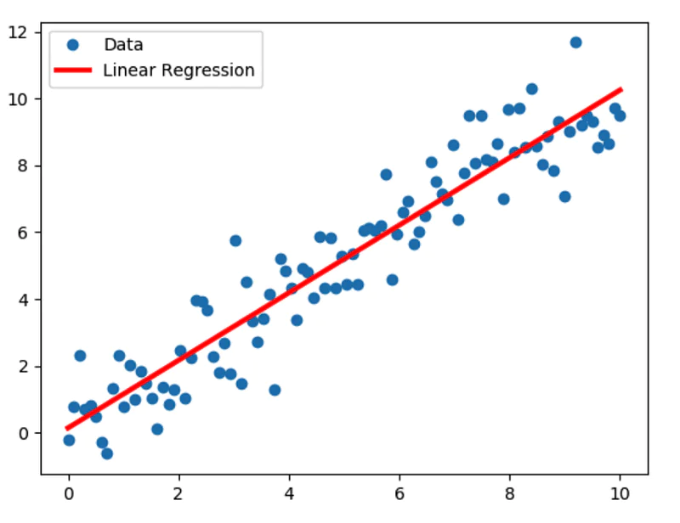
Linear Regression
Linear regression is used to predict the value of a variable based on the value of another variable.
For example, the relationship between temperature and number of ice creams sold.

Slide 6
Popular Classification Algorithms
Logistic Regression
Decision Tree
Support Vector Machine

Slide 7
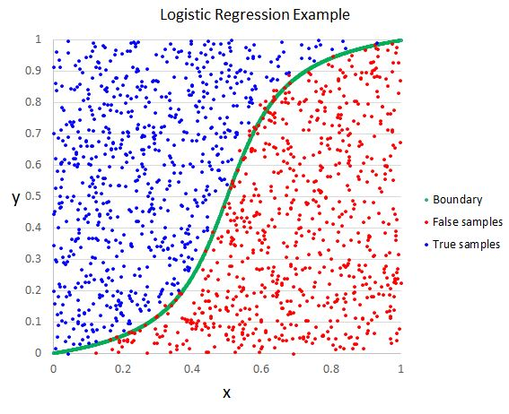
Logistic Regression
Logistic regression estimates the probability of an event occurring, based on a given dataset of independent variables.
Since the outcome is a probability, the dependent variable is bounded between 0 and 1.

Slide 8

Decision Tree Classification
A rule-based approach where internal nodes represent the features of a dataset, branches represent the decision rules and each leaf node represents the outcome.
A decision tree simply asks a question, and based on the answer (Yes/No), it further splits the tree into subtrees.

Slide 9
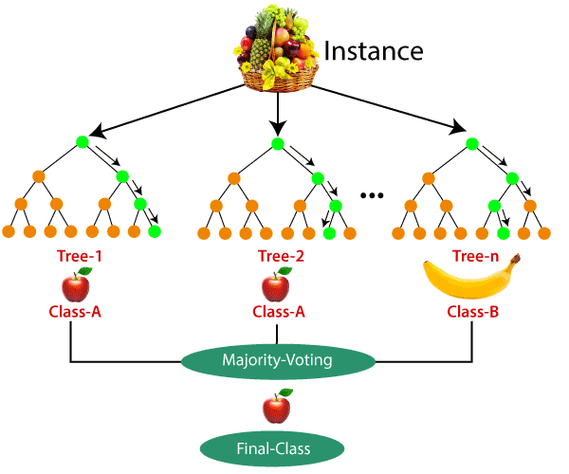
Random Forest Classification
Builds multiple decision trees and merges them together.
The algorithm establishes the outcome based on the predictions of the decision trees. It predicts by taking the average or mean of the output from various trees.
Increasing the number of trees increases the precision of the outcome.

Slide 10
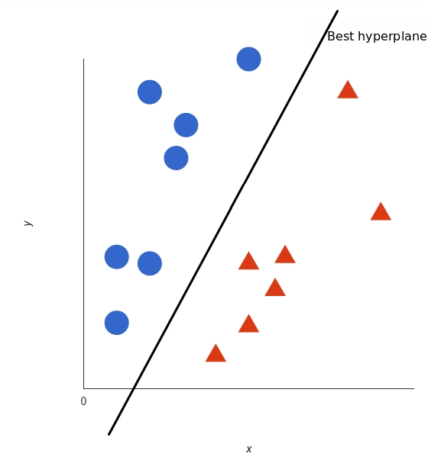
Support Vector Machine (SVM)
A support vector machine takes data points and outputs the hyperplane (which in two dimensions it’s simply a line) that best separates the tags.
This line is the decision boundary: anything that falls to one side of it we will classify as blue, and anything that falls to the other as red.

